Slide 1
Review paper on Elements of Virtual Reality
Basic Idea behind the Virtual Reality and its working.
Applications Drawbacks of VR.
Proposed idea for integrating the science of Neuroprosthetics into the world of Virtual Reality.
Concluding Statements.

Slide 2
Introduction to Virtual Reality
It’s a computer generated environment that takes over the user’s senses immersing the user into a Virtual World. This virtual world is dynamic and responds to the user inputs such as gestures and verbal commands.
Technically Speaking, Virtual Reality is a high-end user interface that involves real-time simulation and interaction through multiple sensorial channels like visual, auditory or tactile channels.

Slide 3
Requirements of Virtual Reality

Slide 4
To Understand the Requirements…

Slide 5
How would a Human being identify the environment around him?

Slide 6
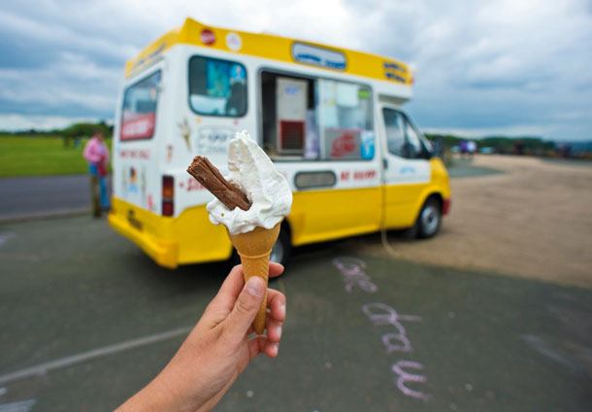
By Seeing

Slide 7
But…
What if you cant see?

Slide 8
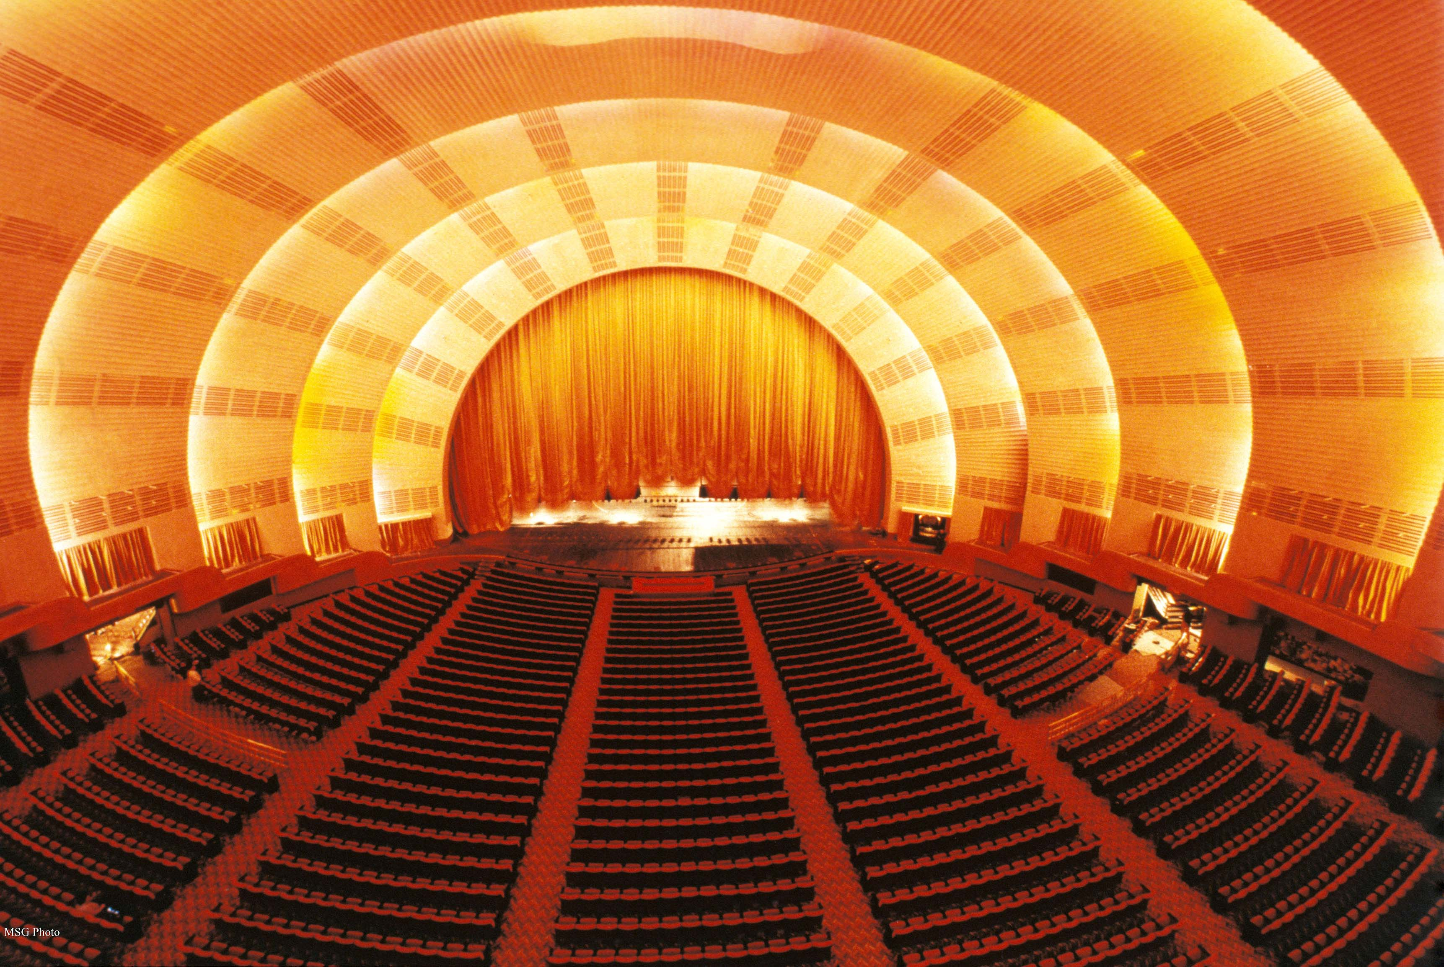

Slide 9
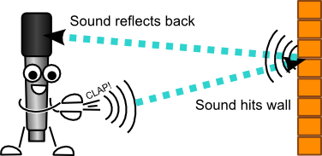

Slide 11
How Else?

Slide 12
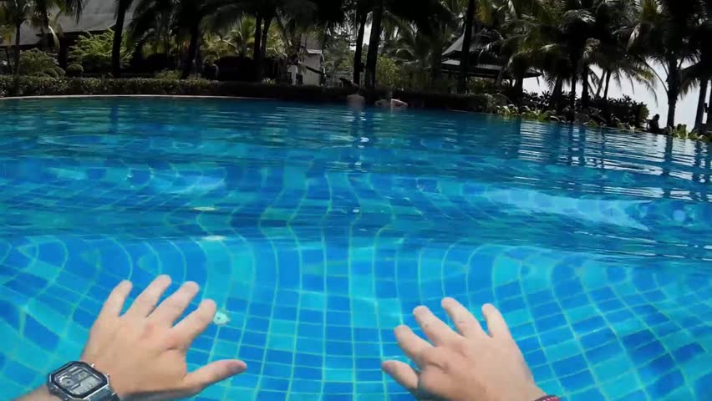

Slide 13
So concluding…
Visual Perception.
Sound Perception.
Touch Perception.

Slide 14
VISUAL PERCEPTION

Slide 15


Slide 16
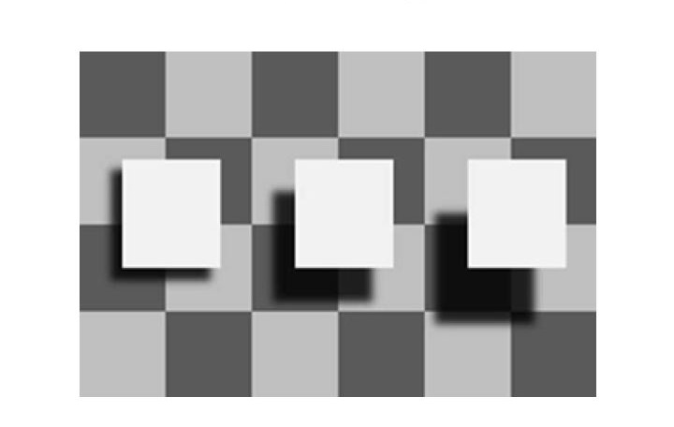
Depth Perception

Slide 18

STEREOSCOPIC VISION

Slide 19


Slide 20
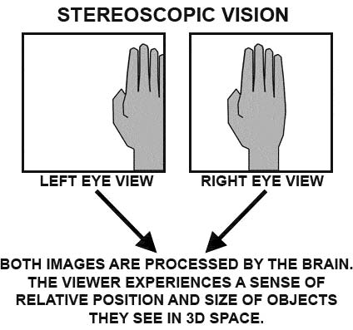

Slide 21
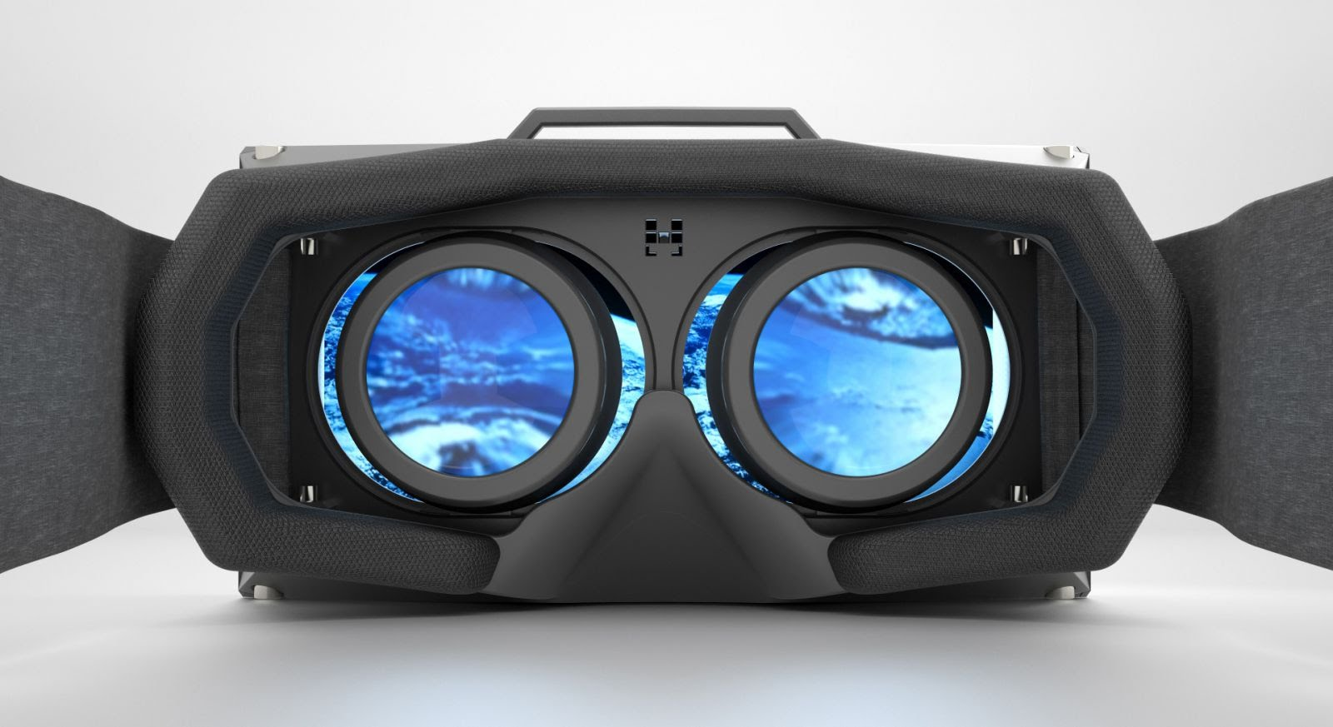

Slide 22
CRITICAL FUSION FREQUENCY

Slide 23
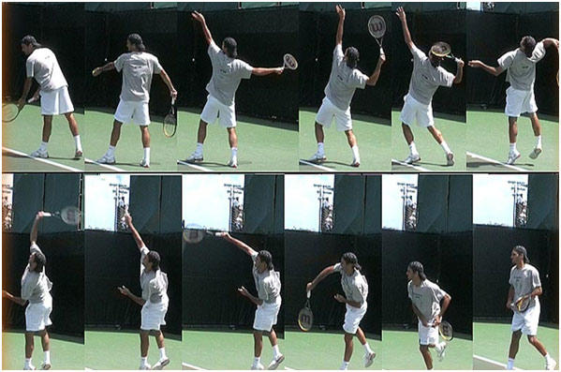
Critical Fusion Frequency

Slide 24
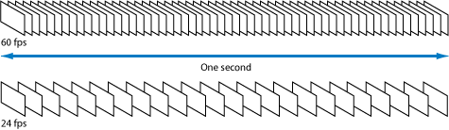

Slide 25
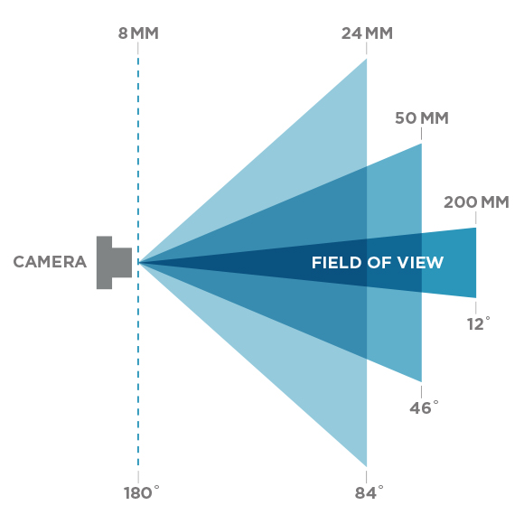
FIELD OF VIEW

Slide 26
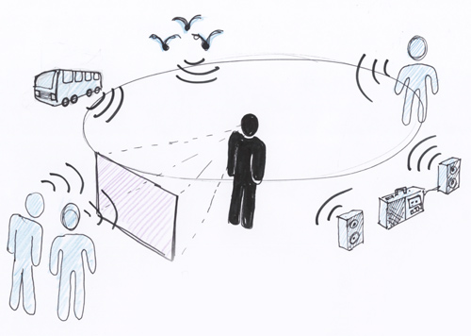
SOUND PERCEPTION

Slide 27
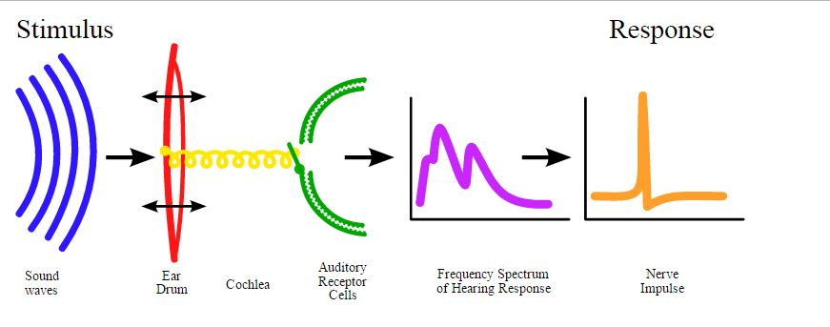

Slide 28
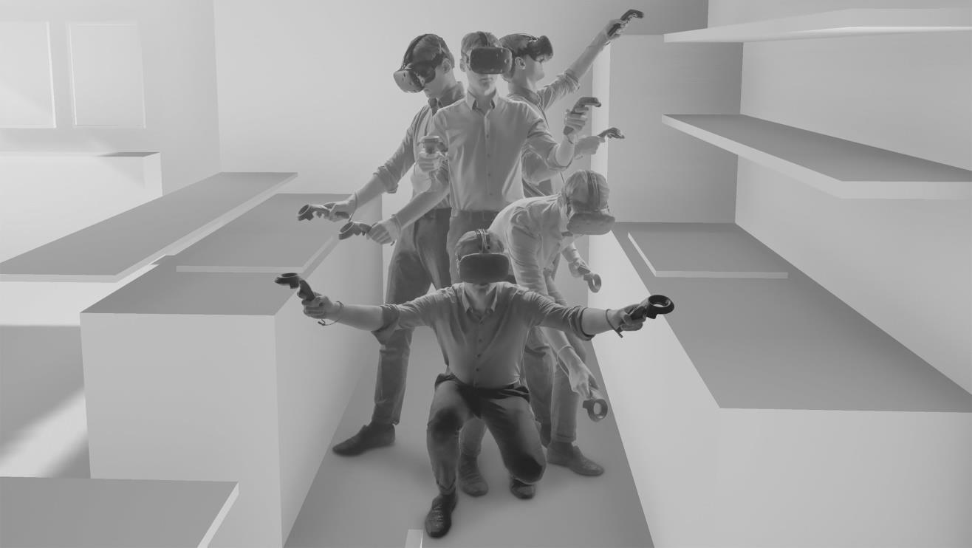
Touch Perception

Slide 29
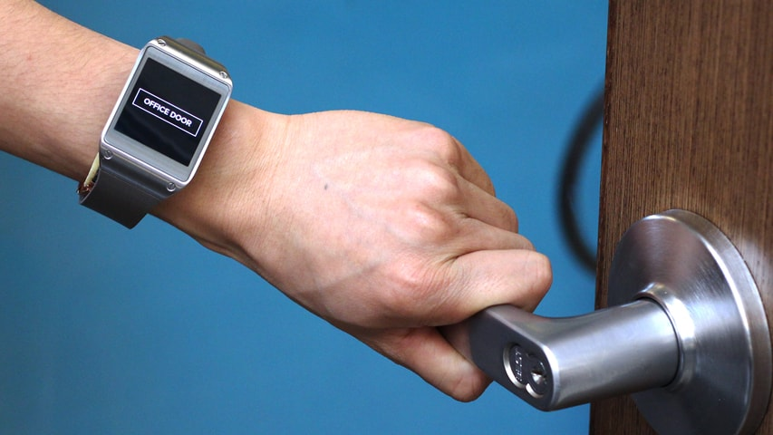
What happens when you grab a Door Handle?

Slide 30
But its just not these three factors that helps us determining about the environment…
The other Supporting factors which cannot be neglected while producing a realistic environment are :
Olfactory Perception
Spatiotemporal Realism

Slide 31
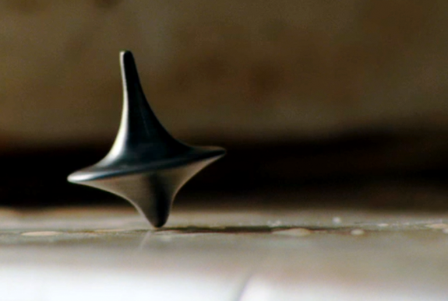
Spatiotemporal Realism
“There is a strict timing constraint which has to be met so as for the application to be usable by a person”

Slide 32

When spatiotemporal constraints are not met…

Slide 33
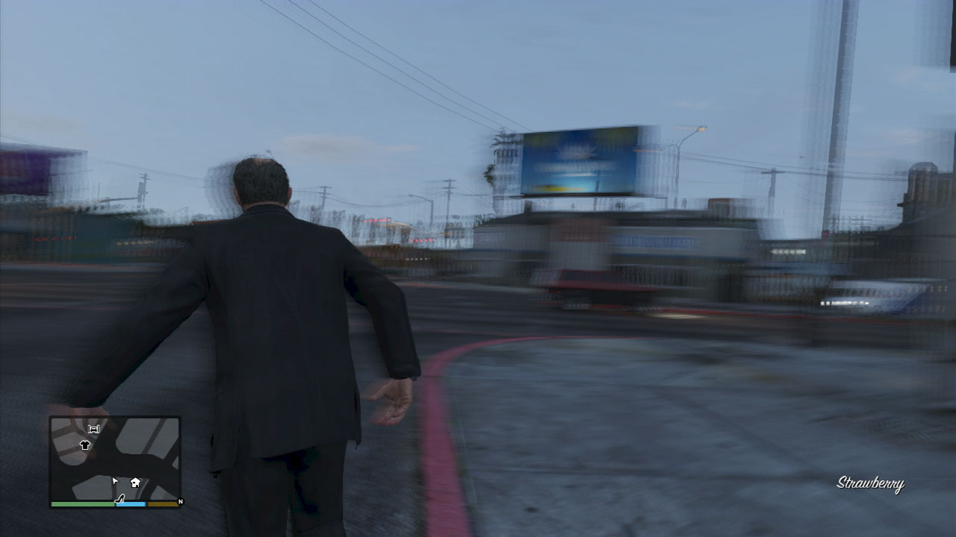

Slide 34
Those were the Requirements
Lets see how all is implemented.

Slide 35
INPUTS
Position Tracking.
Eye Moment Tracking.
Full Body Motion Tracking.

Slide 36
1. Position Tracking
Mechanical
Magnetic
Acoustic
Inertial
Optical

Slide 37
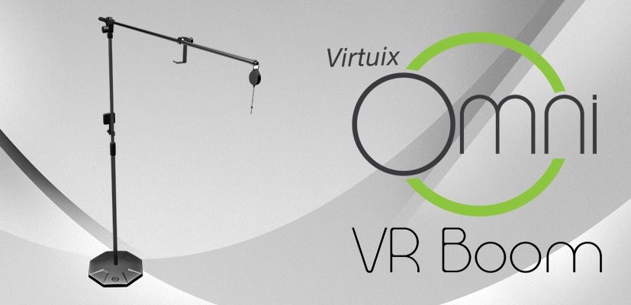

Slide 38
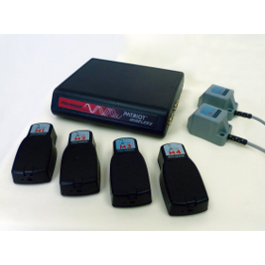

Slide 39
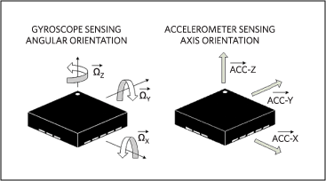

Slide 40
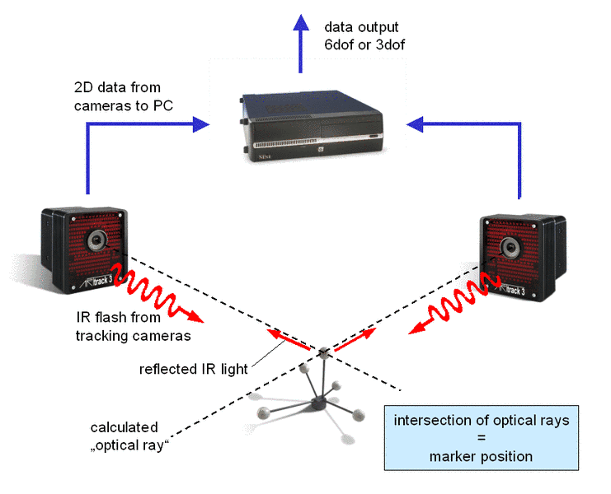

Slide 41
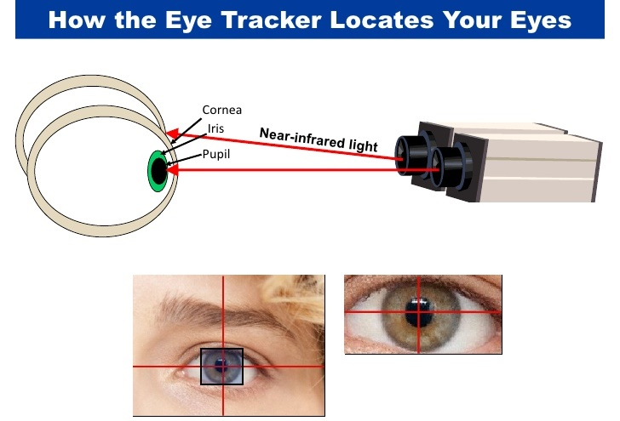
2. Eye Moment Tracking

Slide 42
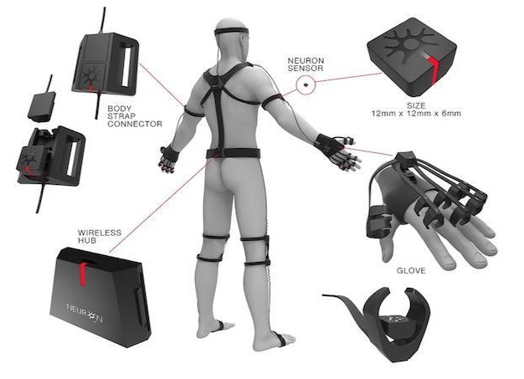
3.Full Body Motion Tracking

Slide 43
OUTPUTS
Visual Feedback
Haptic Feedback
Sound Feedback
Olfactory Feedback

Slide 44
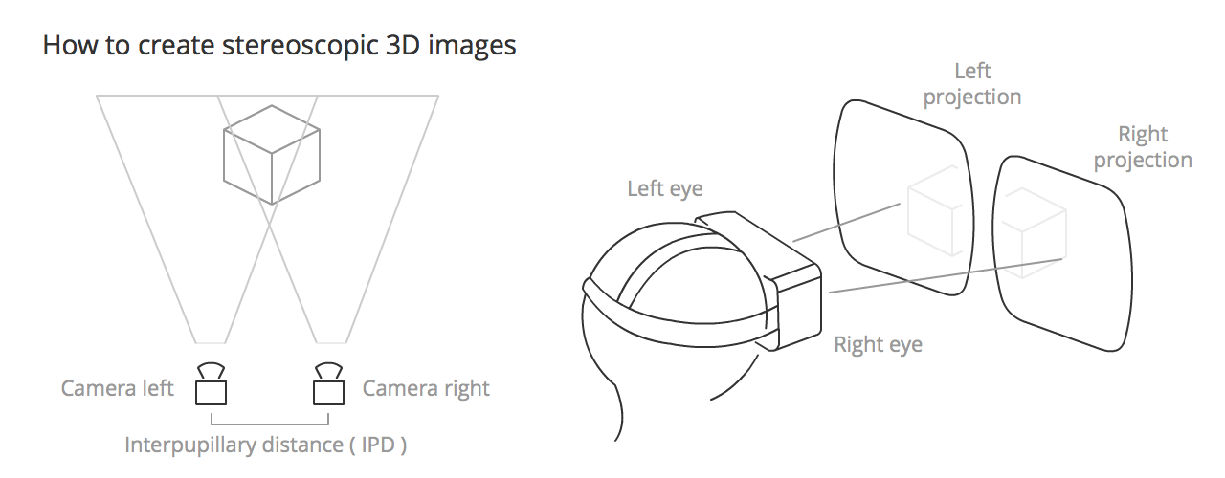
1. Visual Feedback

Slide 45
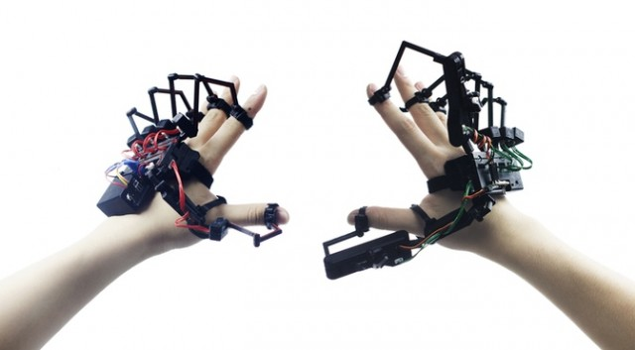
2. Haptic Feedback

Slide 46
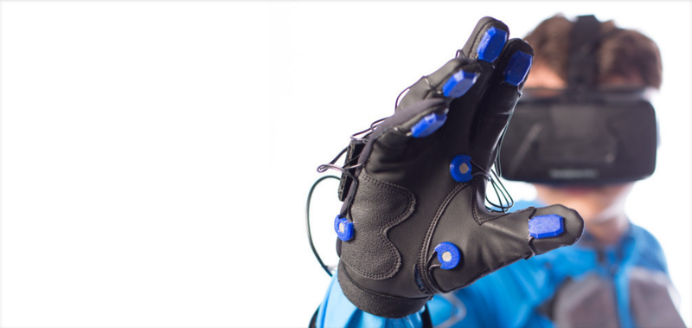

Slide 47
REAL SENSATION OF TOUCH ?

Slide 48
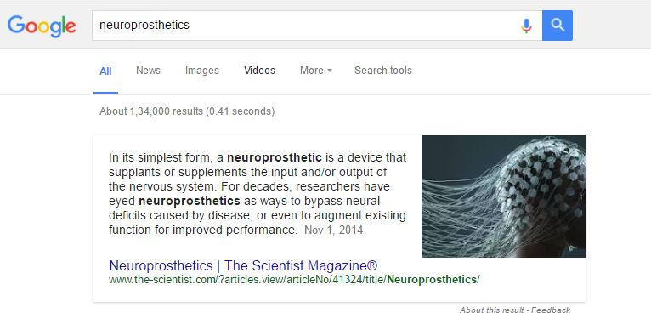
Neuroprosthetics

Slide 49
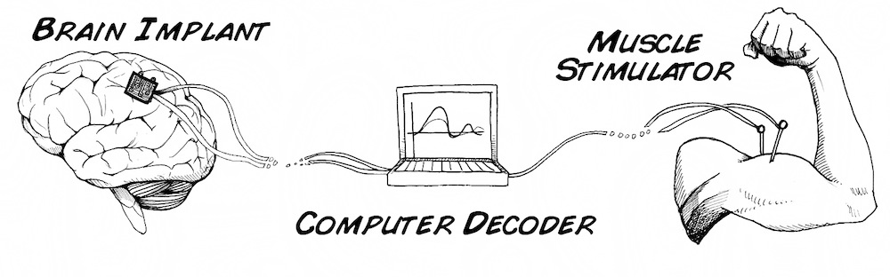
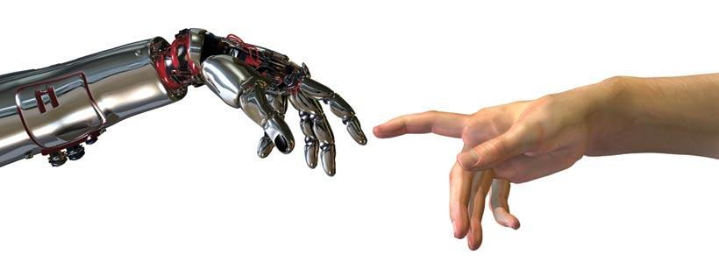

Slide 50
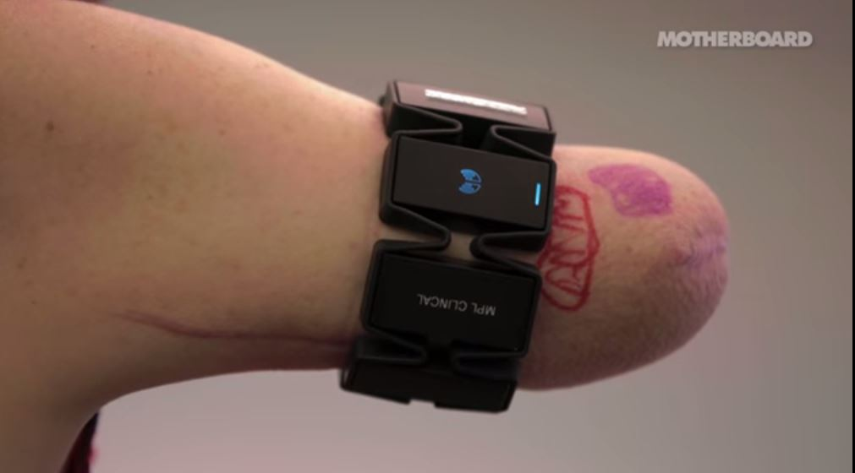

Slide 51
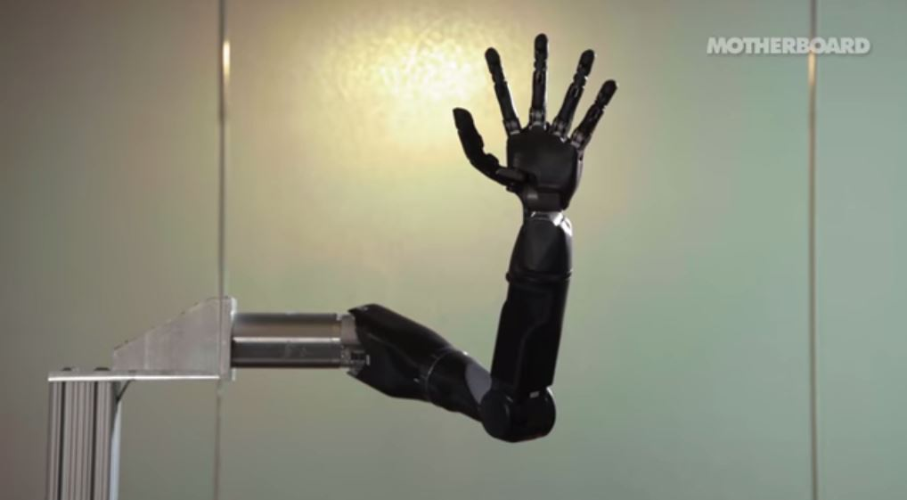

Slide 52
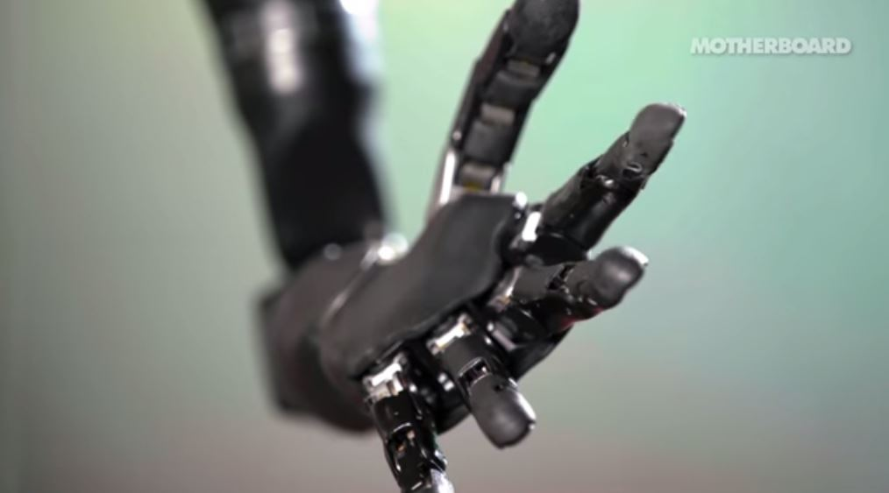

Slide 53
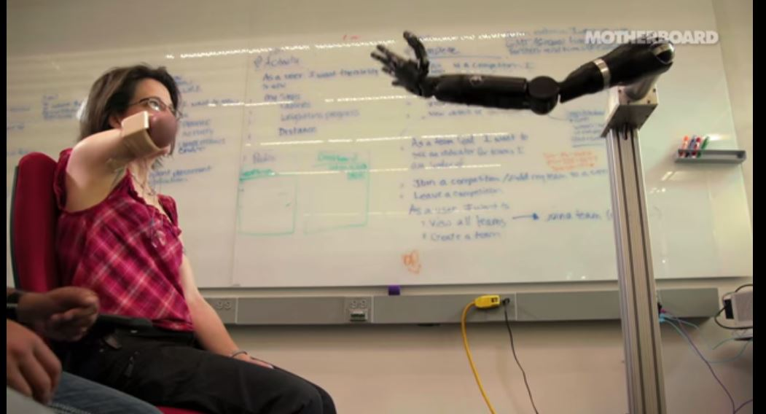

Slide 54
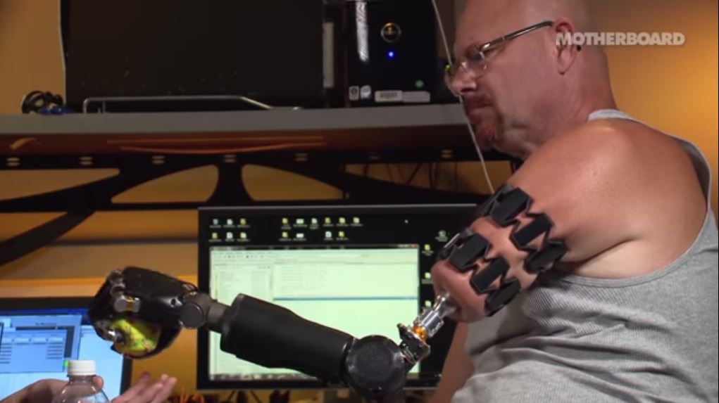

Slide 55
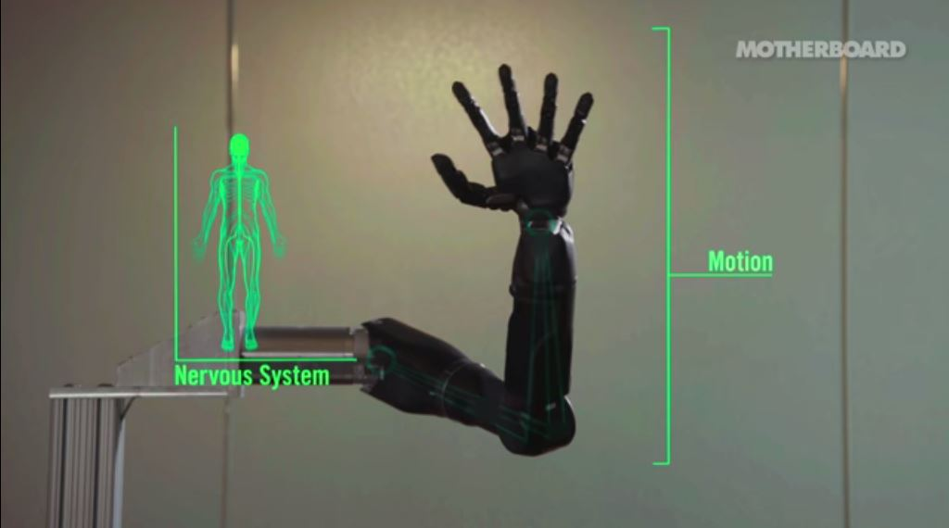

Slide 56
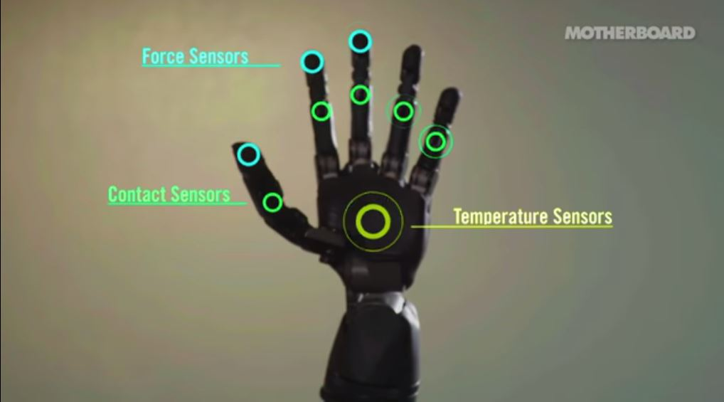

Slide 57
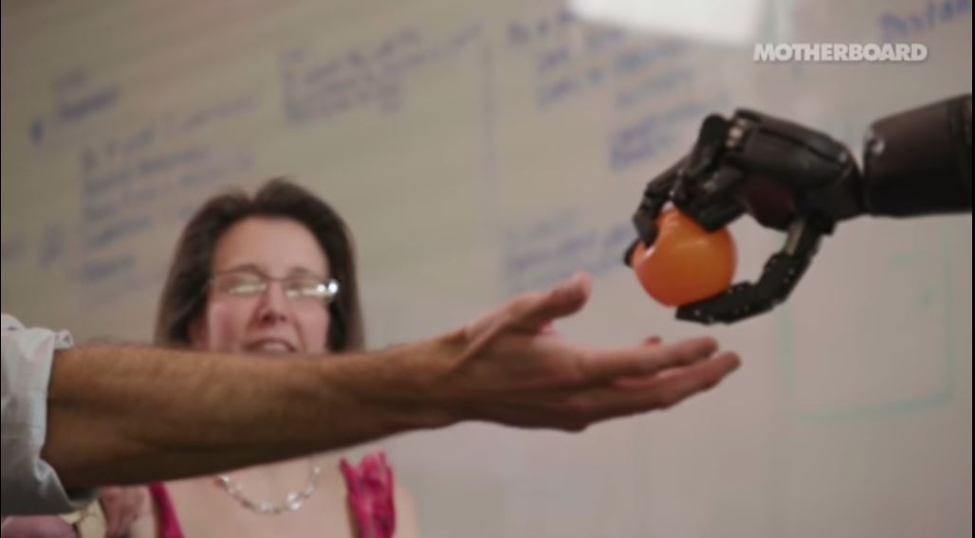

Slide 58
SENSORY REINNERVATION

Slide 59
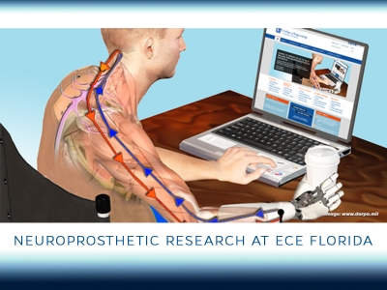

Slide 60


Slide 61
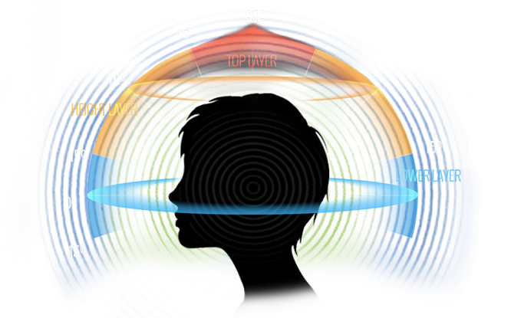
3. Sound Feedback

Slide 62
VR DEVICES
VR Globe
VR CAVE
BOOM
HMD

Slide 63
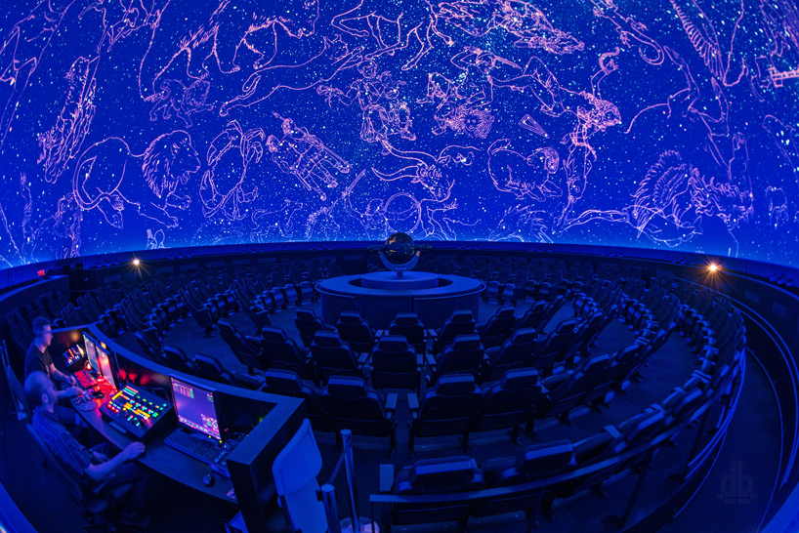

Slide 64
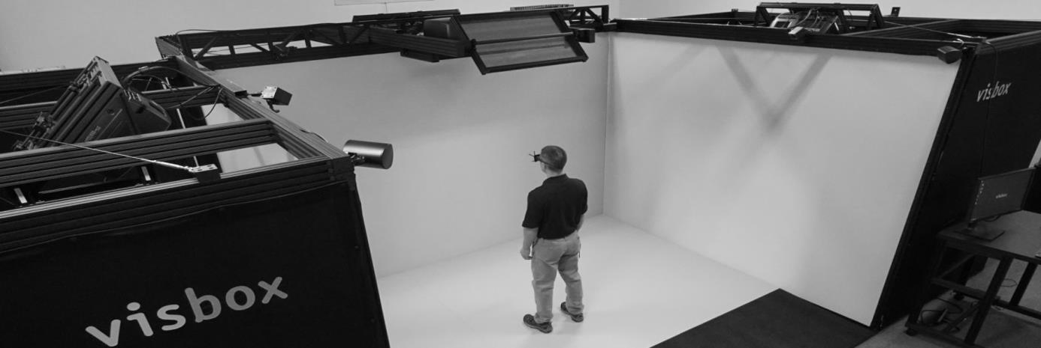

Slide 65
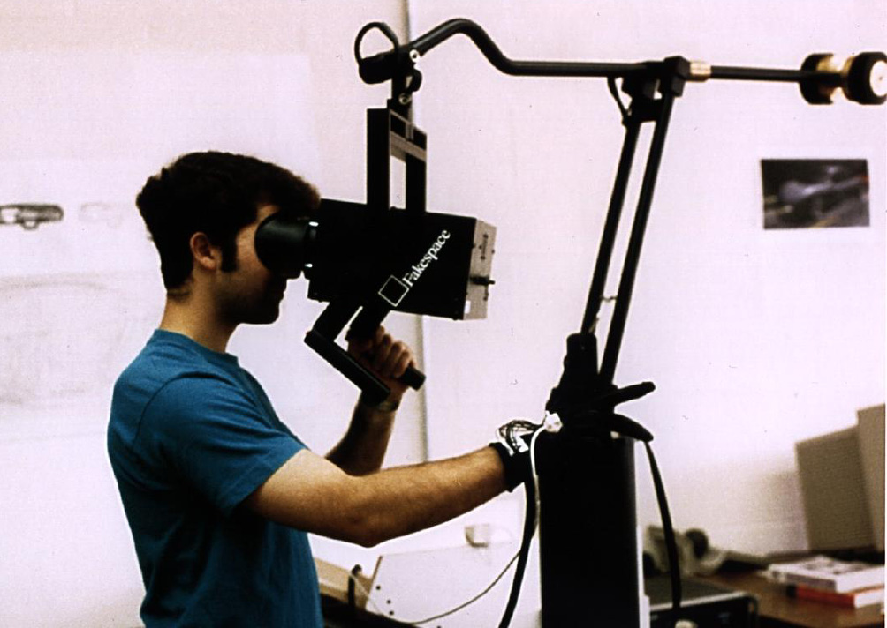

Slide 66


Slide 67
APPLICATIONS OF VIRTUAL REALITY
Anybots
Just Like Being There
Microsoft Zhang
Training Simulators
Medical and Healthcare
Education
Defence
Designing
Engineering
Entertainment

Slide 68
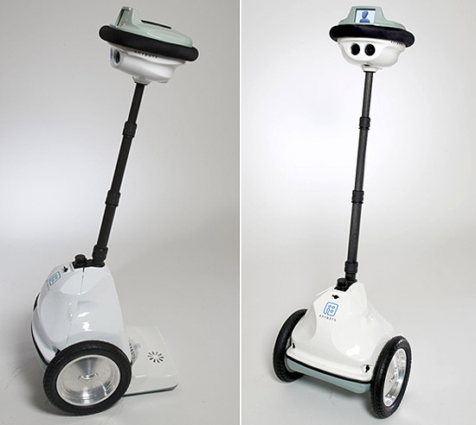

Slide 69
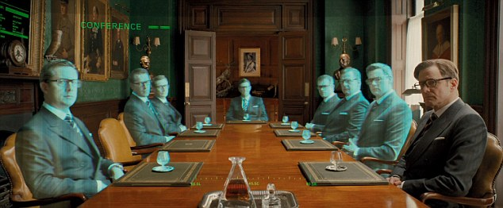

Slide 70
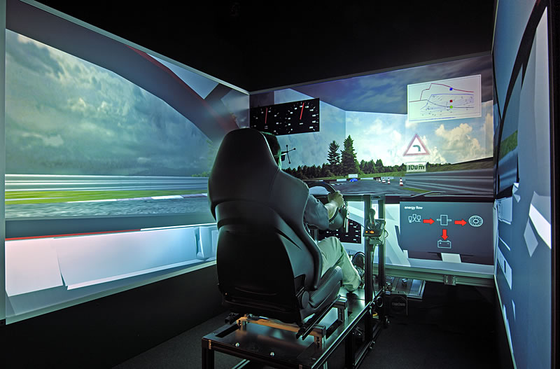

Slide 71
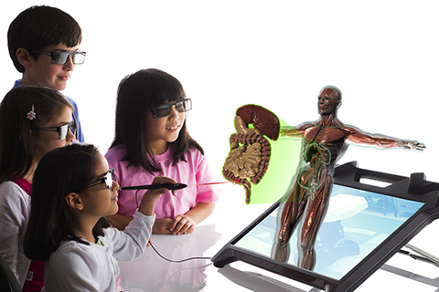

Slide 72
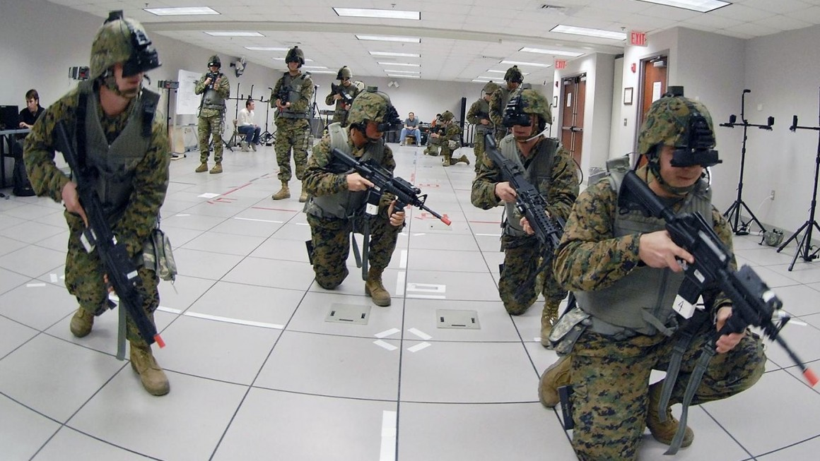

Slide 73
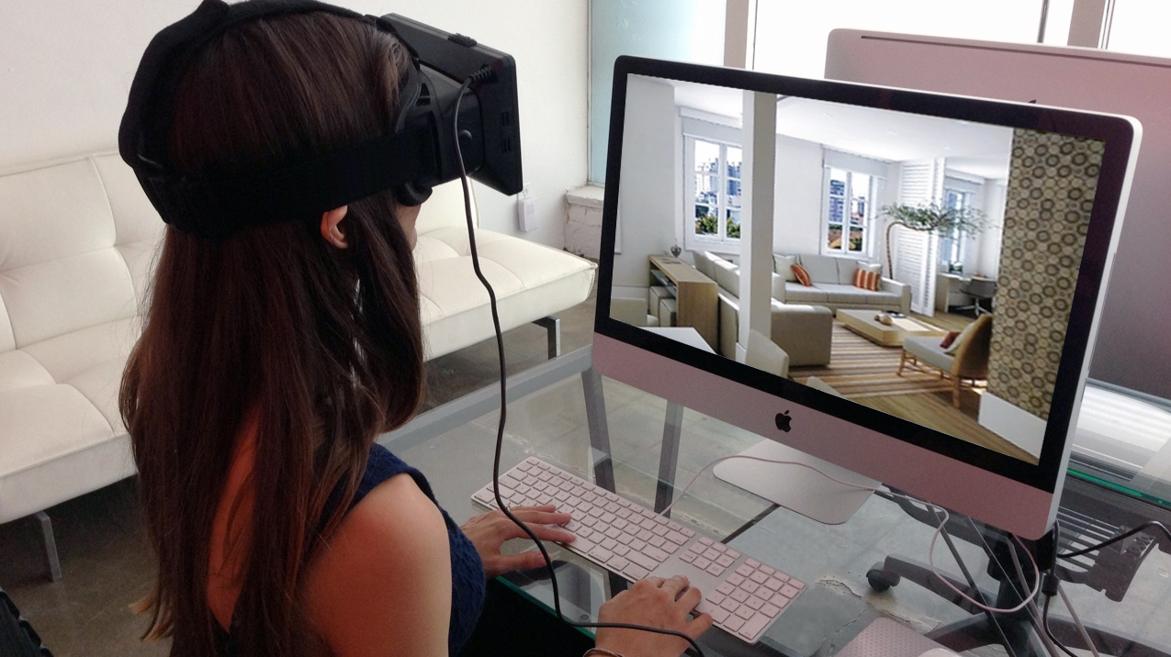

Slide 74


Slide 75
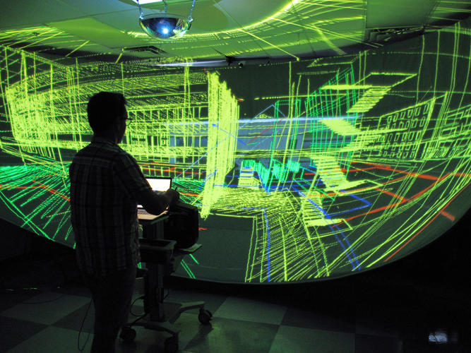

Slide 76
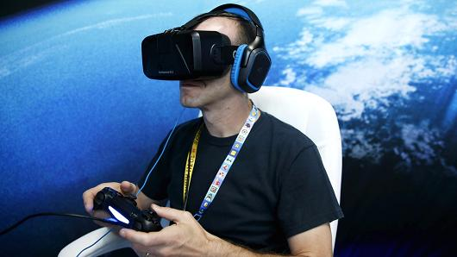

Slide 77
Drawbacks of Virtual Reality
Security, Law Violations and Virtual Criminality
Desensitization
Addictiveness
Health Factors
Effect on the brain development of Children

Slide 78
CONCLUSION

Slide 79
Thankyou
Presented By Dhananjay Trivedi, CSE 3rd Year.

